Slide 1
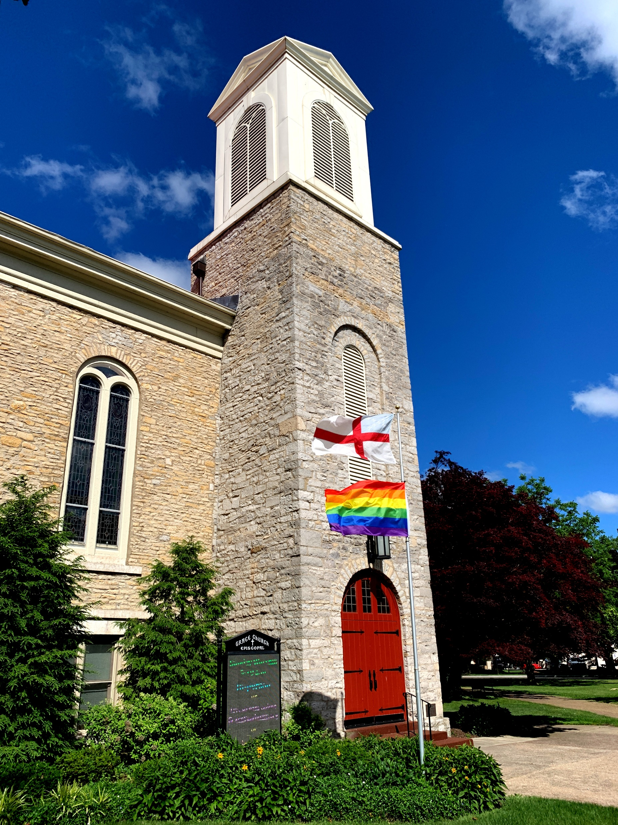
Did you know you can watch Facebook Live without an account?

Slide 2

It’s true.
You don’t need to sign up or log in
to catch your favorite church services.

Slide 3
First, open your web browser and head directly to the church’s official Facebook page – www.facebook.com/GraceEpiscopalSandusky/live

Slide 4
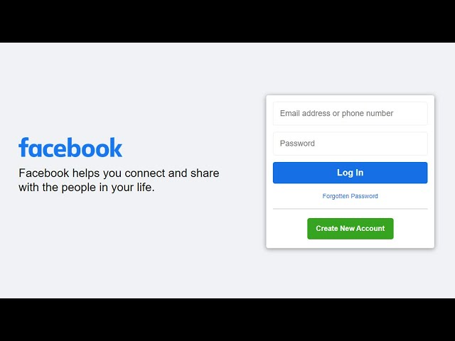
If this screen appears asking you to log in or create an account, you can totally ignore it. There will be an “X” at the top right on this banner. Click it to close.
X

Slide 5
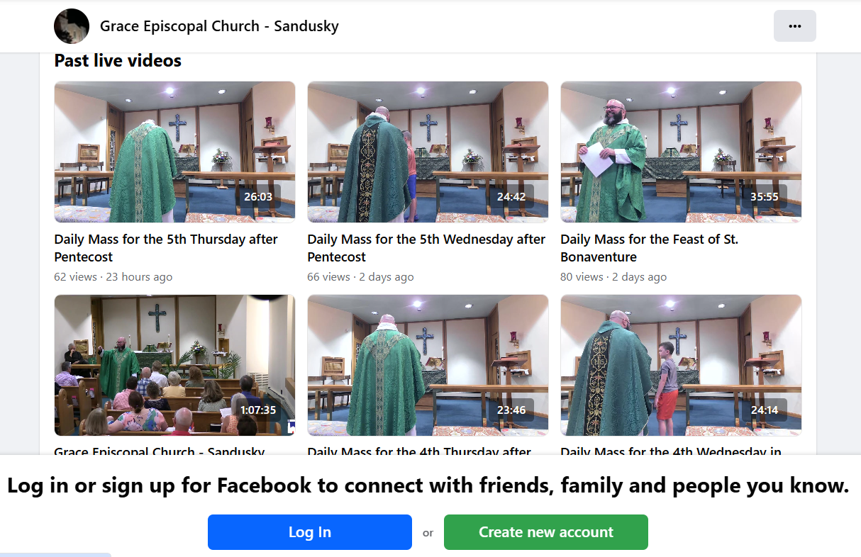
If you’ll notice we’re not actually live right now, so you can view past livestreaming services here too.
Ignore this

Slide 6

Visit Grace’s Facebook page and join the next live service Sunday’s at 10am. We also livestream our 9am Wednesday and Thursday services to our Facebook page. Embrace the experience and stay spiritually connected without the commitment of a Facebook account.
If you do have a Facebook account, don’t forget to like us!

